Slide 1
Ireland’s Facts and Figures 2019
Solution Pack

Slide 2
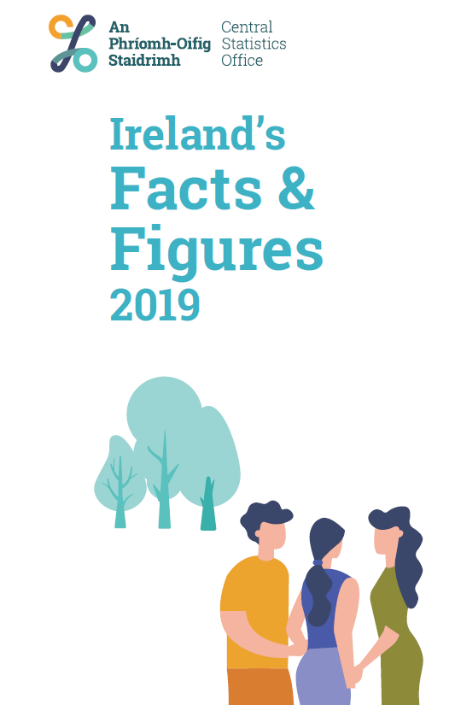
About
This activity pack was designed to accompany the Ireland’s Facts and Figures 2019 Booklet created by the CSO, exploring their data through questions on percentages and charts and graphs.

Slide 3
Table of Contents
1. Population
9. ICT Usage
2. Life Events
10. Business in Ireland
3. Marriages and Deaths
11. Housing
4. Employment & Unemployment
12. Economy and Trade
5. Health
13. Earnings
6. Environment
14. Tourism
7. Equality & Discrimination
15. Transport
8. Education
16. Agriculture
To return to Table of Contents

Slide 4
Population
Section 1
Question 1
Question 2

Slide 5
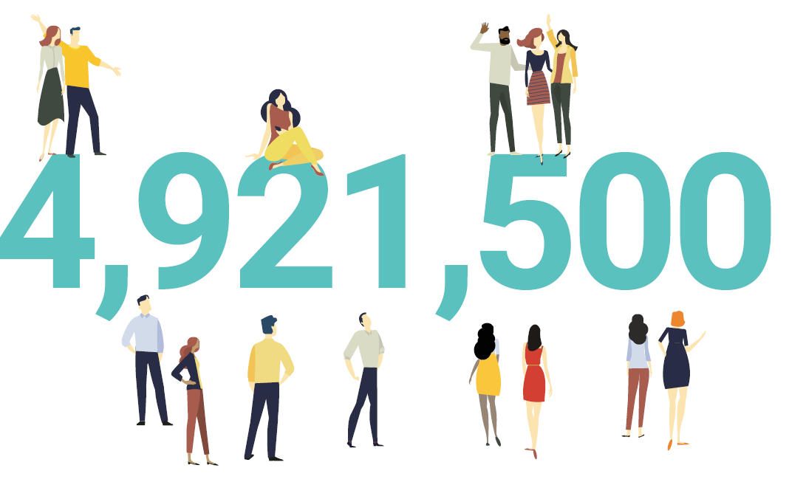
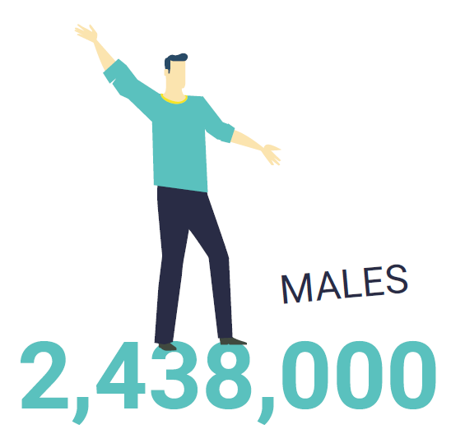
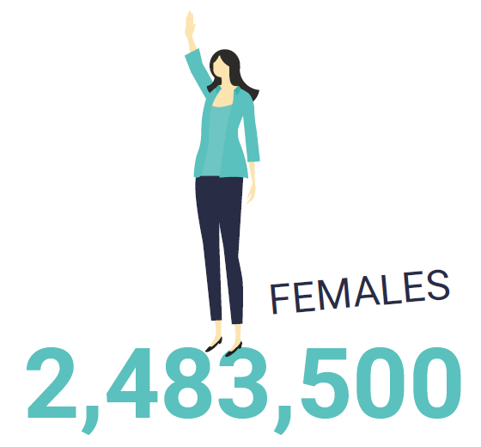
Population
Section 1 : Q1
Use the population figures to calculate, correct to 2 decimal places:
The percentage of the population of Ireland that was male in 2019
The percentage of the population of Ireland that was female in 2019
$$\frac{2,438,000}{4,921,500}×100=49.54\%$$
$$\frac{2,483,500}{4,921,500}×100=50.46\%$$

Slide 6
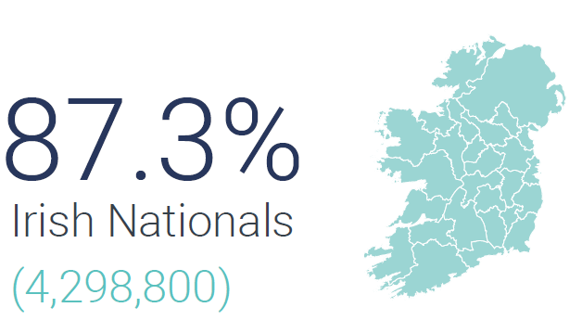
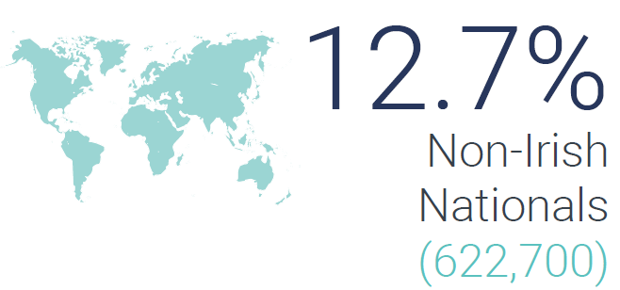
Population
Section 1 : Q2
Create a Pie Chart to represent the proportions of the population of Ireland in 2019 that were Irish Nationals and Non-Irish Nationals.
Category | Population | Percentage | Degrees
Irish Nationals | $$4,298,800$$ | $$87.3\%$$
Irish Non Nationals | $$622,700$$ | $$12.7\%$$
$$314.28°$$
$$45.72°$$
$$\text{Irish} \text{Nationals}$$
$$360×87.3\%=314.28°$$
$$\text{Irish} \text{Non} \text{Nationals}$$
$$360×87.3\%=45.72°$$

Slide 7
Life Events
Section 2
Question 1

Slide 8
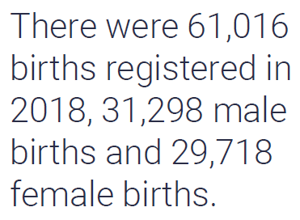
Births
Section 2 : Q1
How many fewer registered births were there in 2018 than in 2008? Does this figure mean that the population of Ireland fell in the 10-year period from 2008 to 2018? Discuss..
Calculate the difference between births in 2008 and 2018.
$$75,173−60,016=15,157$$
Even though the number of births fell from 2008 to 2018 we cannot say that the population fell as there are many other factors including deaths, migration etc

Slide 9
Marriages & Deaths
Section 3
Question 1
Question 2
Question 3

Slide 10
Marriages and Deaths
Section 3 : Q1
What was the total number of people who got married in 2018?
First calculate the TOTAL marriages in 2018.
$$20,389+664=21053$$
We must multiply this by 2…as there are 2 people in each marriage.
$$21053×2=42106$$
42,106 people got married in 2018

Slide 11
Marriages and Deaths
Section 3 : Q2
Create a suitable chart to illustrate the distribution of opposite sex and same sex marriages in 2018.
Category | Number
Opposite Sex | $$20,389$$
Same Sex | $$664$$

Slide 12
Marriages and Deaths
Section 3 : Q2
Create a suitable chart to illustrate the distribution of opposite sex and same sex marriages in 2018.
Category | Number | Degrees
Opposite Sex | $$20,389$$
Same Sex | $$664$$
$$348.65°$$
$$11.35°$$
First calculate the TOTAL marriages in 2018.
$$20,389+664=21053$$
Opposite Sex
$$\frac{20389}{21053}×360=348.65°$$
Same Sex
$$\frac{664}{21053}×360=11.35°$$

Slide 13
Marriages and Deaths
Section 3 : Q3
Using the Registered Birth and Death Figures on pages 6 and 7 calculate the ratios of births to deaths in Ireland in 2018.
Calculate how many births there were per each death in Ireland in 2018
$$\frac{Births}{Deaths}$$
$$=\frac{61016}{31116}$$
$$=1.96$$
Ratio
Births : Deaths
$$1.96 :1$$

Slide 14
Employment & Unemployment
Section 4
Question 1
Question 2

Slide 15
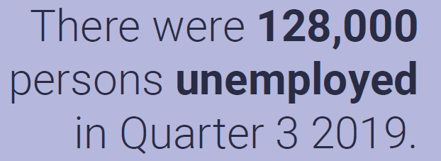
Employment and Unemployment
Section 4 : Q1
Using the estimated population of Ireland on page 5 and the figure for those unemployed in Q3, 2019, calculate the unemployment rate (those unemployed as a percentage of the population).
Unemployment Rate
$$\frac{Unemployed}{Population}×100$$
$$\frac{Unemployed}{Population}×100$$
$$=\frac{128,000}{4,921,500}×100$$
$$=2.6\%$$

Slide 16
Employment and Unemployment
Section 4 : Q2
Using the figure on page 8 for the number of lone parent households in the state in Q3 in 2019, calculate how many households are in the state?
$$239,500=12.6\%$$
$$\frac{239,500}{12.6}×100=100\%$$
$$1,900,794=100\%$$
There were approximately $1,900,794$ households in Ireland in Q3 2019.

Slide 17
Health
Section 5
Question 1
Question 2

Slide 18
Health
Section 6 : Q1
Use the information on page 9 to calculate the Ireland’s Health Expenditure in 2012 and write your answer in digits rather than words, to the nearest euro.
$$€21.1 Billion=21,100,000,000$$
$$21,100,000,000=113\%$$
$$\frac{21,100,000,000}{113}×100=100\%$$
$$18,672,566,370=100\%$$
Ireland’s Health Expenditure in 2012 was approximately €18,672,566,370

Slide 19
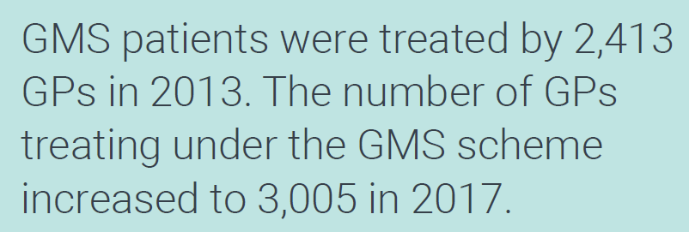
Health
Section 6 : Q2
Calculate the percentage increase in the number of GPs treating under the GMS scheme from 2013 to 2017, correct to 2 decimal places.
Percentage Increase
$$\frac{Increase}{Original}×100$$
$$\frac{Increase}{Original}×100$$
$$=\frac{3005−2413}{2413}×100$$
$$=\frac{592}{2413}×100$$
$$=24.53\%$$

Slide 20
Environment
Section 6
Question 1
Question 2

Slide 21
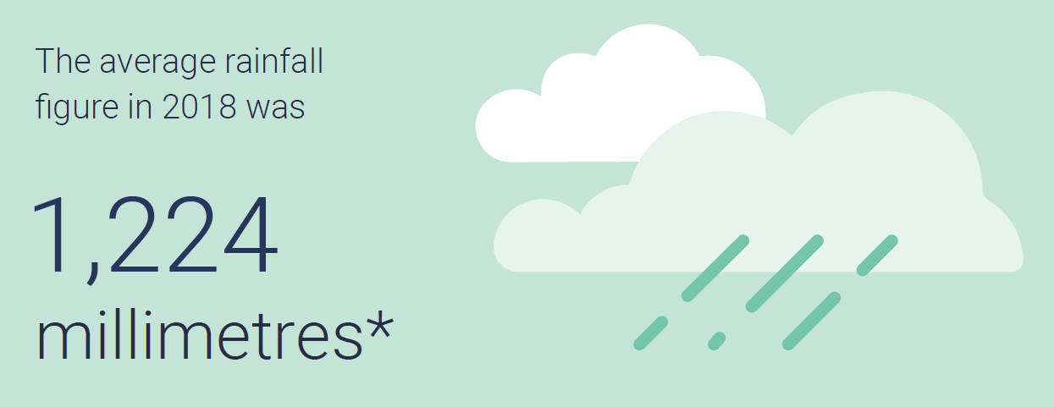
Environment
Section 6 : Q1
Use the figure given for yearly average rainfall to calculate the average rainfall in Ireland:
Per month
Per day (assume a 365 day year)
Per Month
$$\frac{1,224}{12}=102 mm$$
Per Day
$$\frac{1,224}{365}=3.35 mm$$

Slide 22
Environment
Section 6 : Q2
Calculate the percentage decrease in the number of bus and coach passenger journeys from the period 2005 – 2009 to 2018, correct to two decimal places.
Percentage Decrease
$$\frac{Decrease}{Original}×100$$
$$\frac{Decrease}{Original}×100$$
$$=\frac{234.1−226.7}{234.1}×100$$
$$=\frac{7.4}{234.1}×100$$
$$=3.16\%$$

Slide 23
Equality & Discrimination
Section 7
Question 1

Slide 24
Equality and Discrimination
Section 7 : Q1
Four statements are given on page 12. Explain why it is not possible to use a chart to compare the percentages given in those statements?
Whilst we are given a number of percentages, they are not percentages of the same number. For example
33.2% - This is 33.2% of those that identify as LGBTI+.
34.1% - This is 34.1% of those who experienced discrimination.
33.0% - This is 33% of those who experienced discrimination in the workplace.
13.1% - This is 13.1% of those who experienced discrimination in the workplace.

Slide 25
Education
Section 8
Question 1
Question 2
Question 3
Question 4

Slide 26
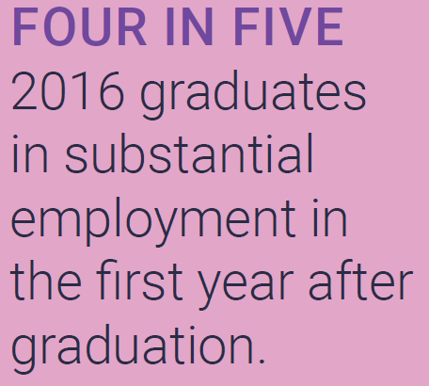
Education
Section 8 : Q1
What percentage of 2016 graduates were in substantial employment in the first year after their graduation?
$$=\frac{4}{5}×100$$
$$=80\%$$

Slide 27
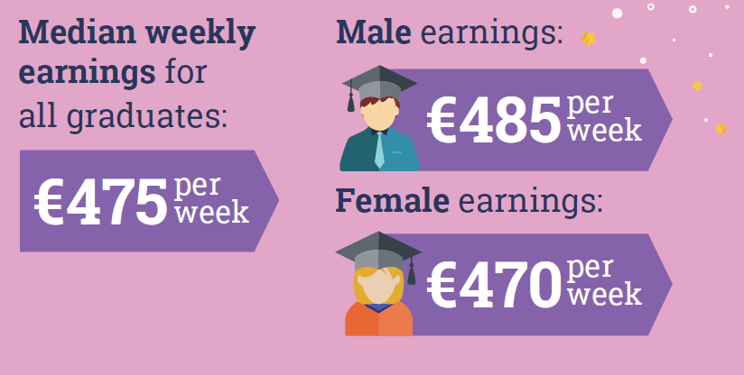
Education
Section 8 : Q2
Estimate the median yearly salary using the figures provided on page 13.
Why do you think the median is given as a measure of the central tendency (measure of the average) instead of the mean?
$$475×52=€24,700$$
Greater Accuracy
$$475×\frac{365}{7}≈€24,768$$
The median is a good measure of the middle of a set of data that may have outliers.
Extreme values, such as unusually high salaries, do not affect the median as strongly as they do the mean.

Slide 28
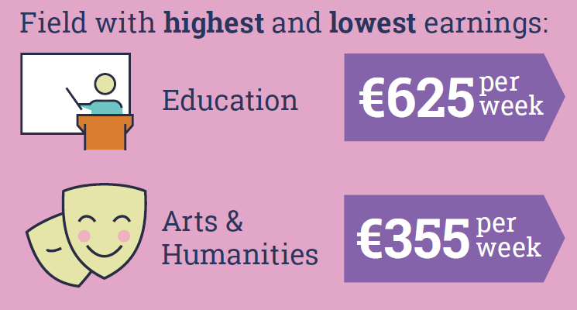
Education
Section 8 : Q3
Calculate the range in highest and lowest earnings.
Range
$$=Highest−Lowest$$
$$625−355=€270$$

Slide 29
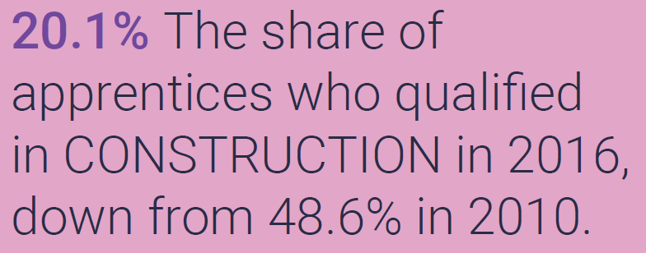
Education
Section 8 : Q4
Can we say that there were less people qualified in construction in 2016 than 2010? Explain your answer through the use of an example.
We can’t say this with certainty. Whilst the percentage is lower in 2016 we do not know the number of apprentices in each of the years.
Take an extreme an example where there were 2000 apprentices in 2010 and 5000 apprentices in 2016.
20.1% of 5,000 is 1005 which is greater than 48.6% of 2000, which is 972.

Slide 30
ICT Usage
Section 9
Question 1

Slide 31
ICT Usage
Section 9 : Q1
Using information on pages 8 and 15 estimate the number of households in Ireland without internet access.
$$239,500=12.6\%$$
$$\frac{239,500}{12.6}×100=100\%$$
$$1,900,794=100\%$$
There were approximately $1,900,794$ households in Ireland in Q3 2019.
If 91% of households HAVE the internet then 9% of household do NOT.
$$1,900,794×0.09=171,071.46$$
Approximately $171,071$ households in Ireland did NOT have internet access in 2019.

Slide 32
Business in Ireland
Section 10
Question 1
Question 2

Slide 33
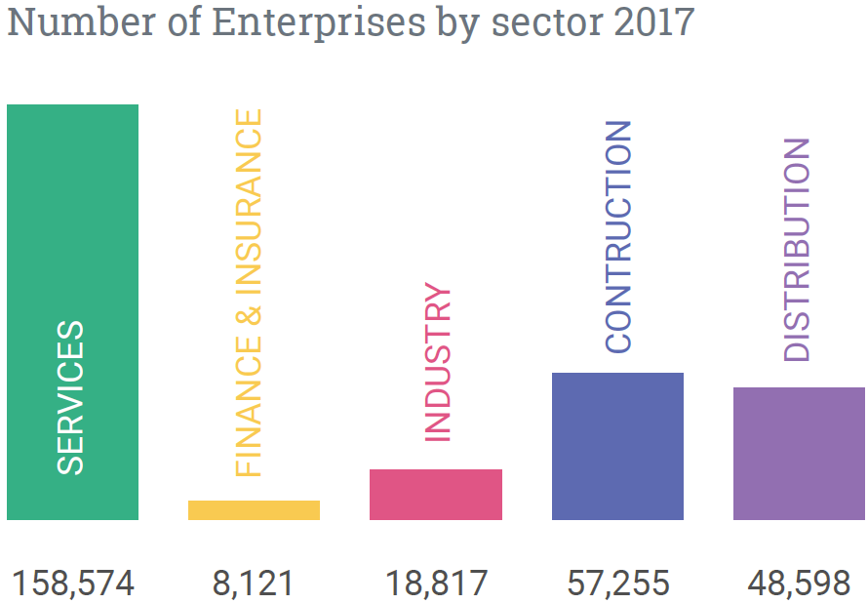
Business in Ireland
Section 10 : Q1
Create a Pie Chart to illustrate the Number of Enterprises by sector in 2017
Services
$$\frac{158,574}{291,365}×360=195.93°$$
Finance and Insurance
$$\frac{8,121}{291,365}×360=10.03°$$
Industry
$$\frac{18,817}{291,365}×360=23.25°$$
Construction
$$\frac{57,255}{291,365}×360=70.74°$$
Total Enterprises
$$291,365$$
Distribution
$$\frac{48,598}{291,365}×360=60.05°$$

Slide 34
Business in Ireland
Section 10 : Q1
Create a Pie Chart to illustrate the Number of Enterprises by sector in 2017
Services
$$\frac{158,574}{291,365}×360=195.93°$$
Finance and Insurance
$$\frac{8,121}{291,365}×360=10.03°$$
Industry
$$\frac{18,817}{291,365}×360=23.25°$$
Construction
$$\frac{57,255}{291,365}×360=70.74°$$
Distribution
$$\frac{48,598}{291,365}×360=60.05°$$

Slide 35
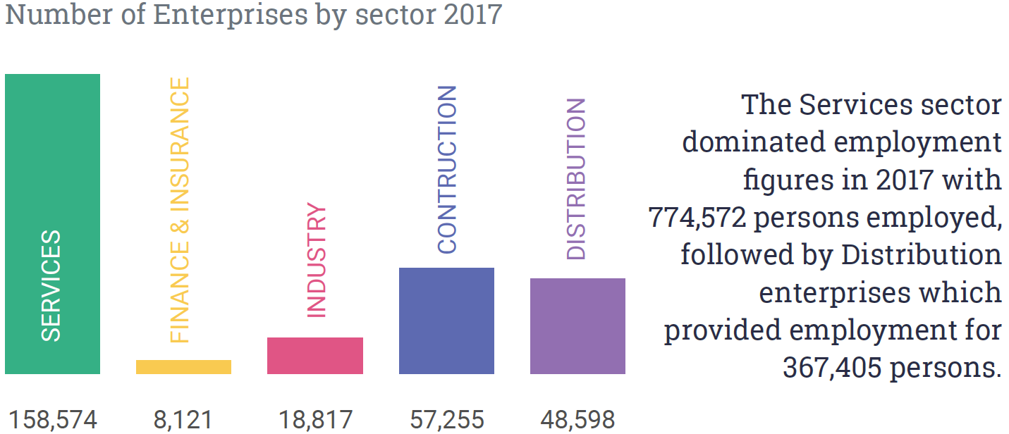
Business in Ireland
Section 10 : Q2
Compare the average number of employees per enterprise in the Services and Distribution sectors in 2017.
Services
Distribution
On average there were 4.88 employees per enterprise in the Services sector compared to 7.56 employees per enterprise in the Distribution sector.
$$\frac{774,572}{158,574}=4.88$$
$$\frac{367,405}{48,598}=7.56$$

Slide 36
Housing
Section 11
Question 1
Question 2
Question 3

Slide 37
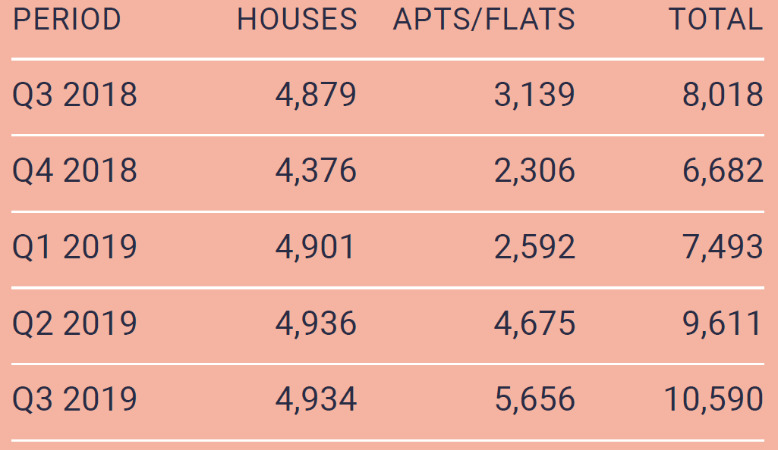
Housing
Section 11 : Q1
Create a suitable chart to illustrate the numbers of houses and apartments/flats granted planning permission from Q3 2018 to Q3 2019.

Slide 38
Housing
Section 11 : Q1
Create a suitable chart to illustrate the numbers of houses and apartments/flats granted planning permission from Q3 2018 to Q3 2019.

Slide 39
Housing
Section 11 : Q2
There was an overall increase of 32.1% in planning permissions granted for dwelling units between Q3 2018 and Q3 2019, which comprised of an 80.2% increase in apartments and a 1.1% increase in houses approved. Use the chart below to confirm these figures.
Apartments
$$\frac{Increase}{Original}×100$$
$$=\frac{5656−3139}{3139}×100$$
$$=\frac{2517}{3139}×100$$
$$=80.185\%$$
$$≈80.2\%$$
Percentage Increase
$$\frac{Increase}{Original}×100$$

Slide 40
Housing
Section 11 : Q2
There was an overall increase of 32.1% in planning permissions granted for dwelling units between Q3 2018 and Q3 2019, which comprised of an 80.2% increase in apartments and a 1.1% increase in houses approved. Use the chart below to confirm these figures.
Houses
$$\frac{Increase}{Original}×100$$
$$=\frac{4934−4879}{4879}×100$$
$$=\frac{55}{4879}×100$$
$$=1.127\%$$
$$≈1.1\%$$
Percentage Increase
$$\frac{Increase}{Original}×100$$

Slide 41
Economy and Trade
Section 12
Question 1
Question 2
Question 3
Question 4
Question 5

Slide 42
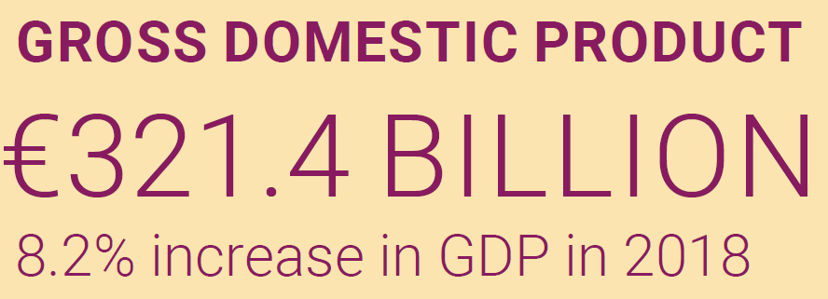
Economy
Section 12 : Q1
Calculate the Gross Domestic Product (GDP) for 2017, correct to 3 significant figures.
$$€321.4 Billion=321,400,000,000$$
$$321,400,000,000=108.2\%$$
$$\frac{321,400,000,000}{108.2}×100=100\%$$
$$297,042,513, 900=100\%$$
Ireland’s GDP in 2017 was approximately €297,000,000,000 or €297 Billion

Slide 43
International Accounts
Section 12 : Q2
The top three countries accounted for 38.7% of exports.
Calculate Ireland’s total exports in 2018, correct to 4 significant figures.
Total exports of top 3 countries.
$$€73.1 billion+$$
$$€51.3 billion$$
$$€28.8 billion$$
$$€153.2 billion$$
$$€153.2 Billion=153,200,000,000$$
$$153,200,000,000=38.7\%$$
$$\frac{153,200,000,000}{38.7}×100=100\%$$
$$395,865,633, 100=100\%$$
Ireland’s exports in 2018 amounted to €395,900,000,000 or €395.9 Billion

Slide 44
Trade
Section 12 : Q3
How many times greater was the value of goods exported in 2018 than the value of goods exported in 1975?
How many times greater was the value of goods imported in 2018 than the value of goods imported in 1975?
$$\frac{140,808 million}{1,838 million}=76.6$$
$$\frac{92,105 million}{2,164 million}=42.6$$

Slide 45
trade
Section 12 : Q4
Confirm that the % increase in the cost of 1kg of Smoked Salmon from 2017 to 2018 is 7.5%.
Percentage Increase
$$\frac{Increase}{Original}×100$$
$$\frac{Increase}{Original}×100$$
$$=\frac{31.49−29.30}{29.30}×100$$
$$=\frac{2.19}{29.30}×100$$
$$=7.47\%$$
$$≈7. 5\%$$

Slide 46
Trade
Section 12 : Q5
Confirm that the % decrease in the cost of 1kg of Fresh Hake from 2017 to 2018 is 2.1%.
Percentage Decrease
$$\frac{Decrease}{Original}×100$$
$$\frac{Decrease}{Original}×100$$
$$=\frac{14.51−14.20}{14.51}×100$$
$$=\frac{0.31}{14.51}×100$$
$$=2.14\%$$
$$≈2. 1\%$$

Slide 47
Earnings
Section 13
Question 1
Question 2

Slide 48
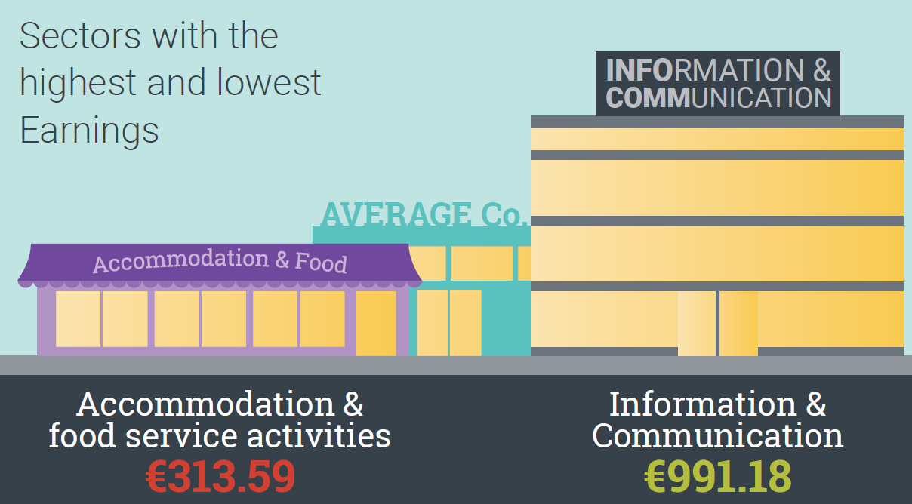
Earnings
Section 13 : Q1
Calculate the range between the sectors with the highest and lowest average earnings.
Range
$$=Highest−Lowest$$
$$991.18−313.59=€677.59$$

Slide 49
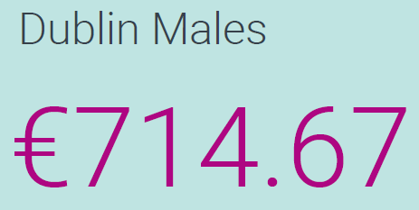
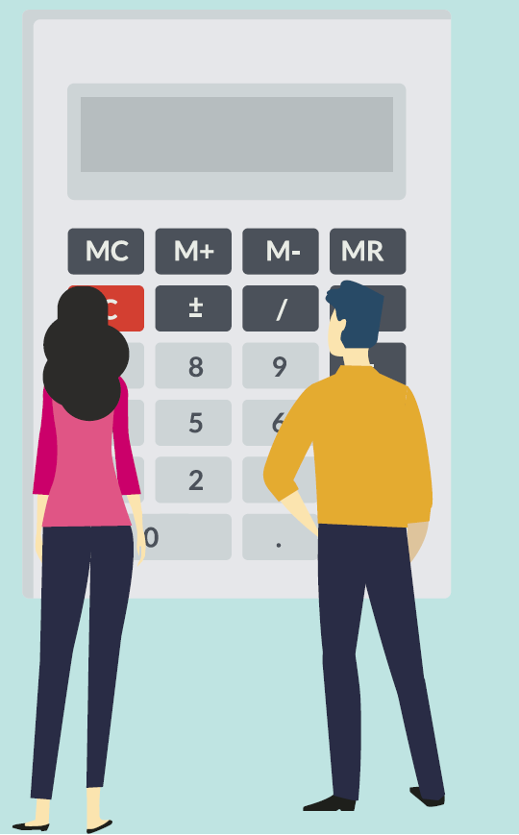
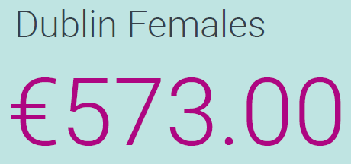
Earnings
Section 13 : Q2
Calculate the difference between the median weekly earnings of females and males in Dublin as a percentage of the median weekly female earnings.
$$\frac{714.67−573}{573}×100$$
$$=\frac{141.67}{573}×100$$
$$=24.72\%$$
The median weekly earnings of males in Dublin is 24.72% higher than the median weekly earnings of females in Dublin.

Slide 50
Tourism
Section 14
Question 1
Question 2
Question 3

Slide 51
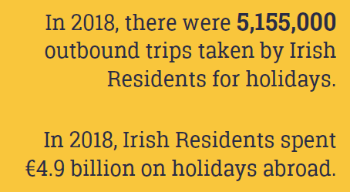
Tourism
Section 14 : Q1
Calculate the average spend per trip by Irish residents on holidays abroad.
$$4.9 Billion=4,900,000,000$$
$$Average Spend$$
$$=\frac{4,900,000,000}{5,155,000}$$
$$=950.53$$
The average spend by Irish residents on holidays abroad was €950.53

Slide 52
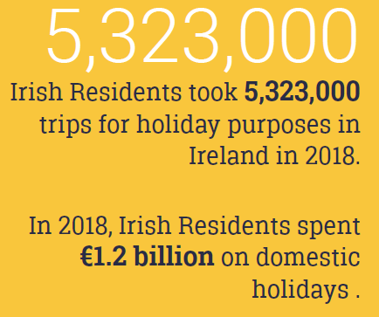
Tourism
Section 14 : Q2
Calculate the average spend by Irish residents on holidays in Ireland.
$$Average Spend$$
$$=\frac{1,200,000,000}{5,323,000}$$
$$=225.44$$
The average spend by Irish residents on holidays in Ireland was €225.44
$$1.2 Billion=1,200,000,000$$

Slide 53
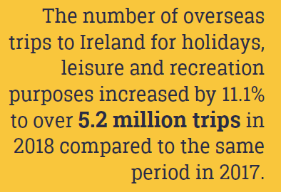
Tourism
Section 14 : Q3
Estimate the number of oversees trips to Ireland for holidays, leisure and recreation purposes in 2017, to three significant figures.
$$€5.2 Million=5,200,000$$
$$5,200,000=111.1\%$$
$$\frac{5,200,000}{111.1}×100=100\%$$
$$4,680,468.047=100\%$$
The number of oversees trips to Ireland for holidays, leisure and recreation purposes in 2017 was approximately 4,680,000.

Slide 54
Transport
Section 15
Question 1
Question 2
Question 3
Question 4

Slide 55
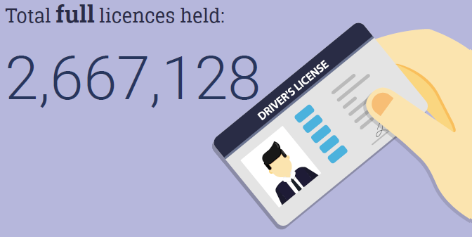
Transport
Section 15 : Q1
What was the percentage of licensed drivers that were aged 80 and over in 2018, correct to two decimal places?
$$\% Drivers Aged 80 and Over$$
$$=\frac{73,194}{2,667,128}×100$$
$$=2.74\%$$
2.74% of drivers were aged 80 or over.

Slide 56
Transport
Section 15 : Q2
What was the percentage of licensed drivers that were in the 40-49 age group in 2018, correct to two decimal places?
$$\% Drivers Aged 40−49$$
$$=\frac{600,255}{2,667,128}×100$$
$$=22.51\%$$
22.51% of drivers were aged between 40 and 49.

Slide 57
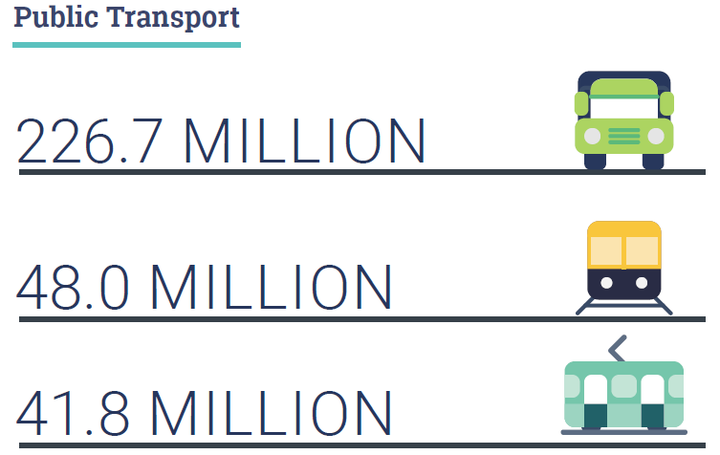
Transport
Section 15 : Q3
Create a suitable chart to illustrate the number of users for each of the three modes of public transport.
Passengers (in Millions)

Slide 58
Transport
Section 15 : Q4
Calculate the average number of passengers per cruise ship that arrived in Ireland in 2018.
$$Average Number of Passengers$$
$$=\frac{398,505}{300}×100$$
$$=1328.35$$
There were an average of 1328 passengers per cruise ship.

Slide 59
Agriculture
Section 16
Question 1
Question 2
Question 3
Question 4
Question 5

Slide 60
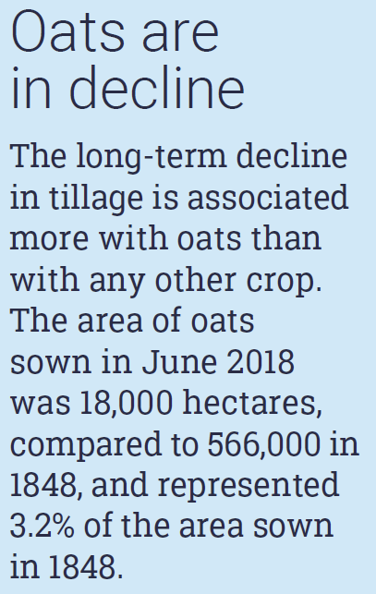
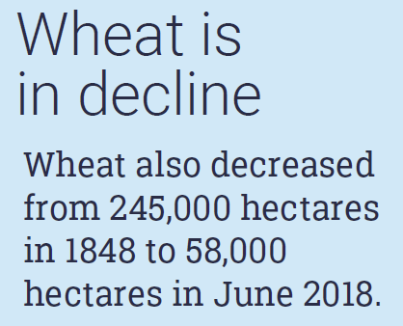
Agriculture
Section 16 : Q1
Express each of the areas of oats and wheat sown in 2018 as a percentage of the respective areas sown in 1848.
$$\frac{58,000}{245,000}×100=23.67\%$$
$$\frac{18,000}{566,000}×100=3.18\%$$

Slide 61
Agriculture
Section 16 : Q2
Calculate the percentage increase in the area of barley sown from 1848 to 2018.
Percentage Increase
$$\frac{Increase}{Original}×100$$
$$\frac{Increase}{Original}×100$$
$$=\frac{185,000−119,000}{119,000}×100$$
$$=\frac{66,000}{119,000}×100$$
$$=55.46\%$$

Slide 62
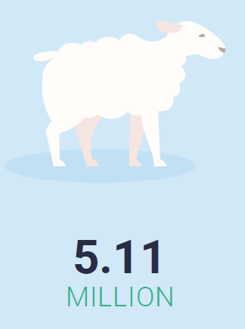
Agriculture
Section 16 : Q3
How many sheep were there in Ireland in 2017?
$$2018$$
$$€5.11 Million=5,110,000$$
$$5,110,000=98.3\%$$
$$\frac{5,110,000}{98.3}×100=100\%$$
$$5,198,372.33=100\%$$
There were approximately 5,198,372 sheep in Ireland in 2017.

Slide 63
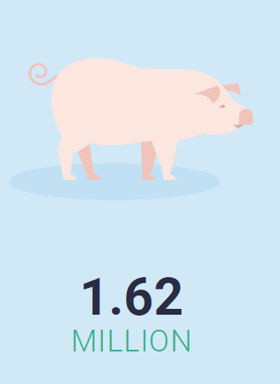
Agriculture
Section 16 : Q4
How many pigs were there in Ireland in 2017?
$$2018$$
$$€1.62 Million=1,620,000$$
$$1,620,000=104.2\%$$
$$\frac{1,620,000}{104.2}×100=100\%$$
$$1,554,702.495=100\%$$
There were approximately 1,554,703 pigs in Ireland in 2017.

Slide 64
Agriculture
Section 16 : Q5
Calculate the difference between the mean and median prices of an acre of agricultural land sold in Ireland in 2018.
Mean
$$=\frac{210,800,000}{37,436}$$
$$=5630.94$$
Median
$$=6,444$$
$$210.8 million=210,800,000$$
Difference
$$=6444−5630.94$$
$$=€813.06$$

